Slide 1
Bacteriophages

Slide 2
Course overview
Gene and phage annotation (31.3)
Phage taxonomy (7.4)
CRISPR arrays, repeats and Cas-genes (14.4)
CRISPR-/Proto-spacer (21.4)
Conclusions (28.4)

Slide 3
Todays Overview
Introduction to phages
Morphology
Life Cycle
Phage Assay
Group session (with Philipp)
What do phages need to live? Gene annotation
First Subgroup work (gene annotation)
How do we detect active phage system?
Second Subgroup work (coverage detection)
Discussion and preperation for next week

Slide 4
Introduction
Bacteriophages are viruses that infect bacteria
Twort et al. 1915 first described “phages” after seeing that broth cultures dissolved after addition of a bacteria-free filtrate obtained from sewage
‘Phages are the most abundant and diverse biological entities on the planet’ (Huge diversity of phages because the mutate and replicate very fast)
Phages are not actually a organism in the tree of life because they cannot replicate themselves but are dependant on the host replication

Slide 5
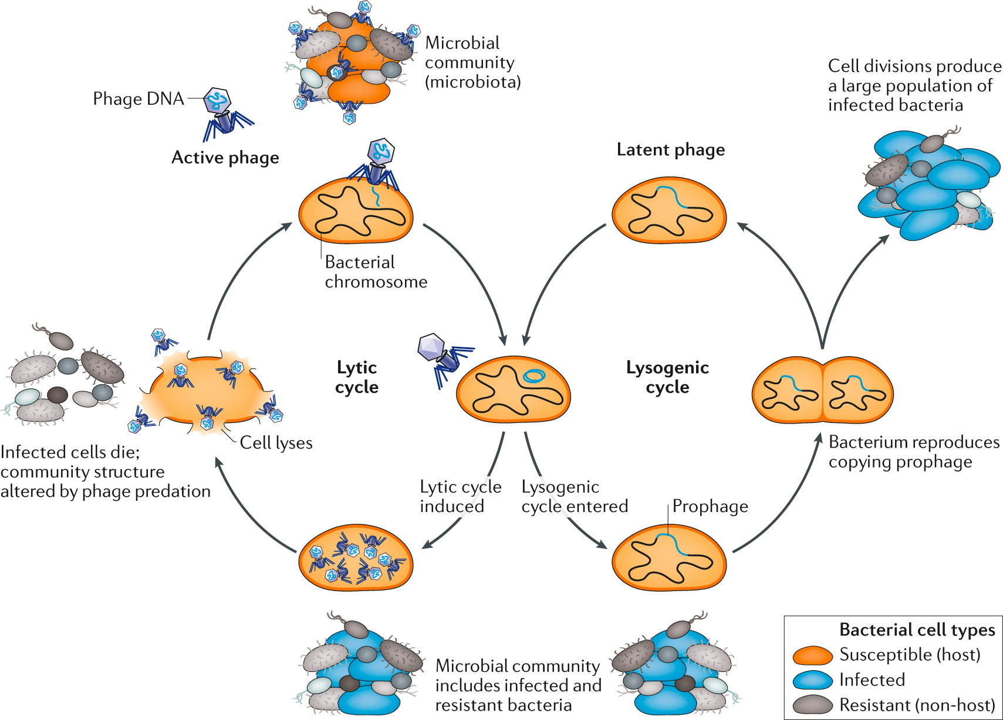
Phage replication
- phages need a host to replicate
- two life cycles (either or)
- often a narrow host range
(1 phage ~ few bacteria)
Garretto et al. 2019

Slide 6
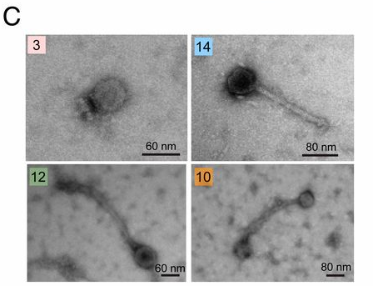
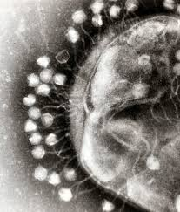
Moropholoy: Phages under the microscope
Very small and proteinacious
German et al. 2020

Slide 7
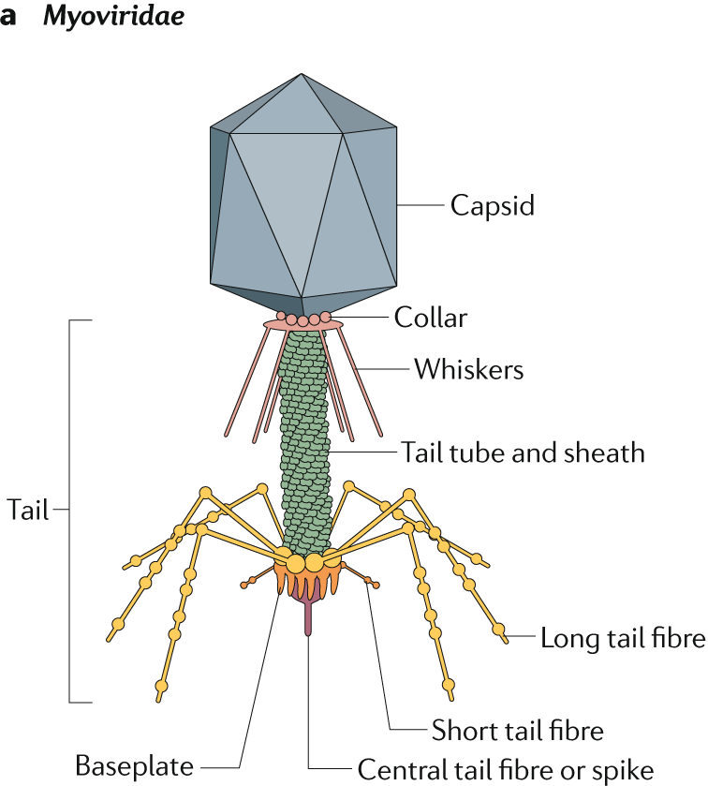
Phage morphology
Receptor binding proteins (RBPs) tip of the tail or at the baseplate
Frank Oechslin et al. 2020

Slide 8
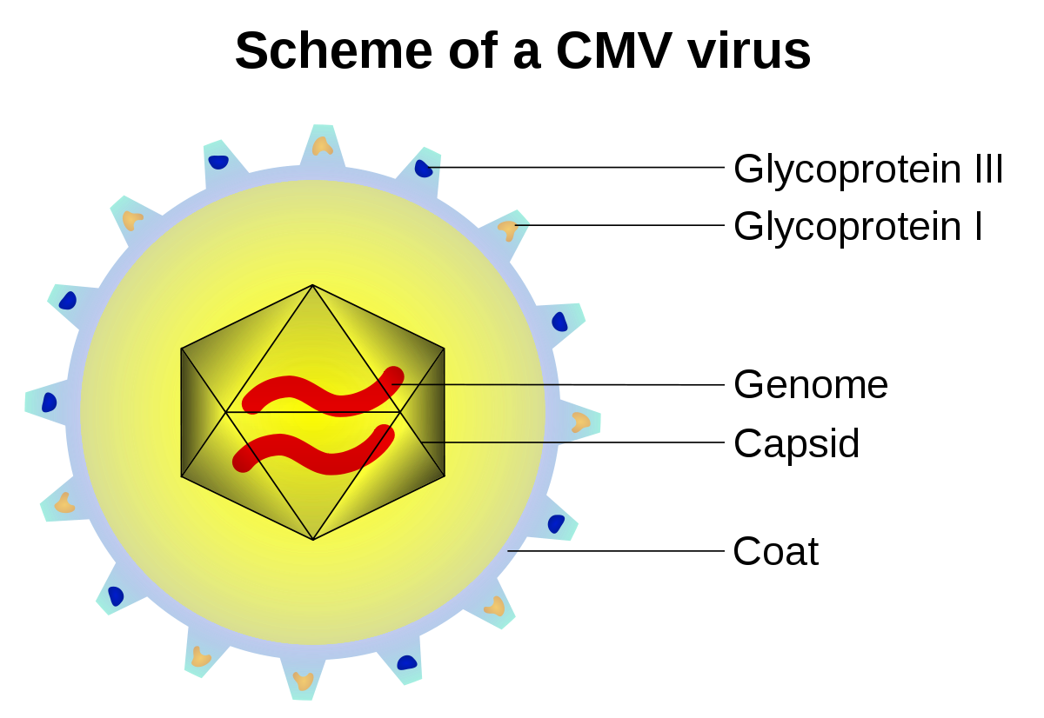
Phage morphology
Very Proteinacious surface (like Viruses)
That is why washing hands with soap (detergent) will “kill” phages and viruses
Frank Oechslin et al. 2020

Slide 9
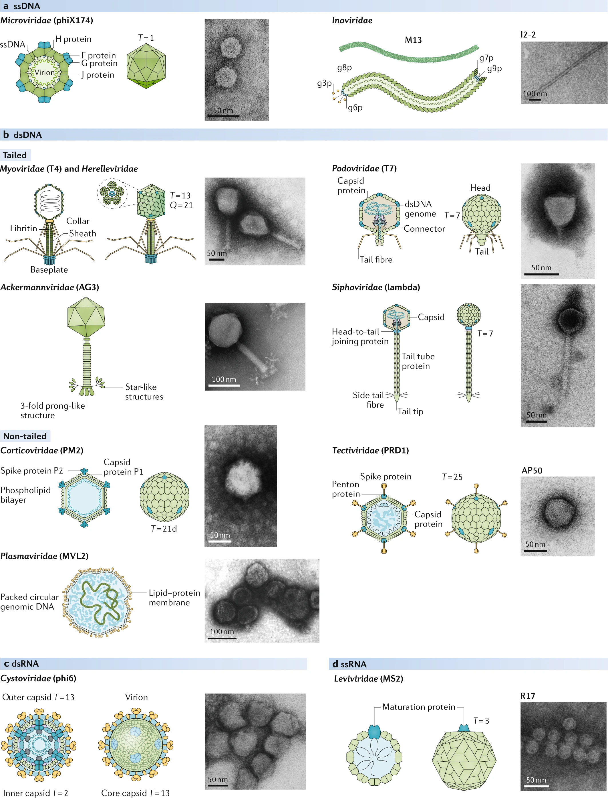
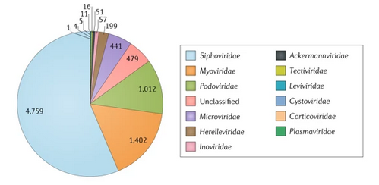
Phage taxonomy (sneak peak)
Frank Oechslin et al. 2020

Slide 10
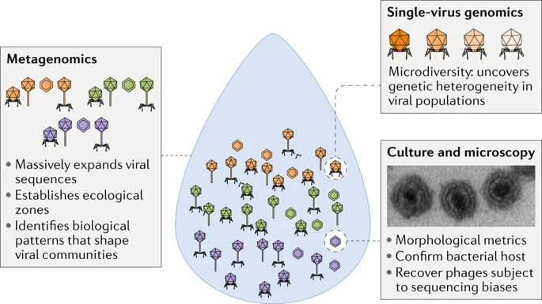
Phage Detection
Large majority of phages genomes we know today are from metagenomes!

Slide 11
Gene genomes
Big diversity in genomic molekule
double-stranded DNA (dsDNA)
single-stranded DNA (ssDNA)
single-stranded RNA (ssRNA)
double-stranded RNA (dsRNA)
Big diversity in size (2,435 bp - >540 kb (megaphages))
Little homology (“It also became clear that no single gene or protein exists in all phage genomes, making it difficult to build a tree based on a single, shared genomic feature”)

Slide 12
Gene annotation
What is gene annotation?
How do we annotate genes
Start codon /Stop codon
TATA box
Motives
In phages it can all be different

Slide 13
What do phages need to live?
Scan through the PHASTER
Addtionally I did Prophage annotation with an another (commandline-tool) Virsorter
Annotated 7 Prophages https://docs.google.com/spreadsheets/d/1YyVHvu8BxhOTGxskBc00aURRp-yN7BMEJRMXlPiwFqg/edit#gid=848482125
I have created fna (genome file) and faa files (amino acid files) to annotate the genomes

Slide 14
What do phages need to live?
Morphogenes (tail, capsid, Fiber, Coat)
Replication (polymerase, tRNA, Protease, Lysis, Terminase)
Insertion (prophages specific, Attachment Site, attl, attr, integrase)
Search individually online and gather some information to share with the group

Slide 15
What do phages need to live?
Morphogenes ( http://biodev.cea.fr/virfam/ )
Replication
Insertion (prophages specific)
Search individually online and gather some information to share with the group

Slide 16
Course overview
Gene and phage annotation (31.3)
Phage classification (21.4)
CRISPR arrays, repeats and Cas-genes (27.4)
CRISPR-/Proto-spacer
Conclusions

Slide 17
Last time overview
Introduction to phages
Morphology
Life Cycle
Phage Assay
Group session (with Philipp)
What do phages need to live? Gene annotation
First Subgroup work (gene annotation)
How do we detect active phage system?
Second Subgroup work (coverage detection)
Discussion and preparation for next week

Slide 18
Today schedule
Introduction: Role of phages
Recapitulating: Talking about the genome annotations and the coverage plots
Outlook: Next steps for the report
Group session (with Philipp)
Introduction: phage taxonomy/classification
Subgroup work: Gathering genomes for phylogeny
Scan phage network

Slide 19
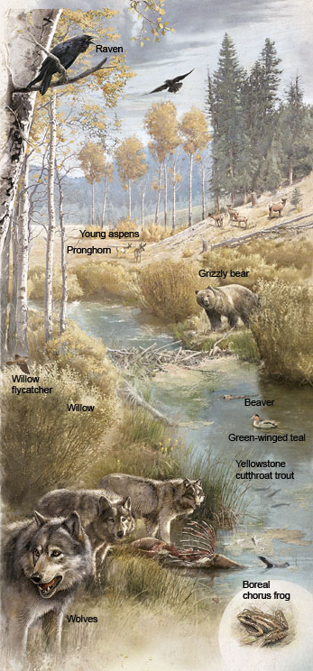
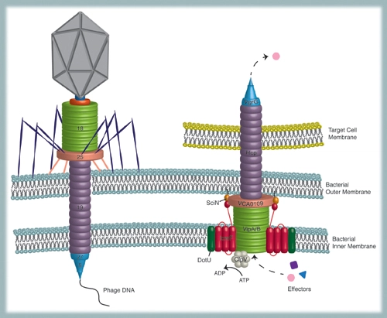
Role and functioning of phages

Slide 20
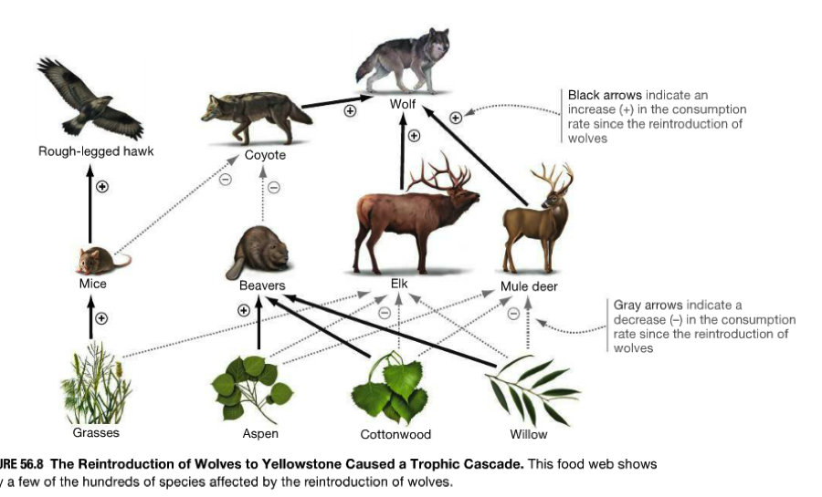
Role and functioning of phages
Top predators
Major regulators of bacterial diversity
(Kim et al. 2018)
http://scholar.google.com/scholar_lookup?&title=Lysogeny%20is%20prevalent%20and%20widely%20distributed%20in%20the%20murine%20gut%20microbiota&journal=ISME%20J.&volume=12&pages=1127-1141&publication_year=2018&author=Kim%2CM-S&author=Bae%2CJ-W

Slide 21
Role and functioning of phages
Top predators
Major regulators of bacterial diversity
Bring functional genes to bacteria
(Oechslin et al. 2020)
https://www.nature.com/articles/s41579-019-0311-5

Slide 22
Role and functioning of phages
Top predators
Major regulators of bacterial diversity
Bring functional genes to bacteria
Horizontal gene transfer vector

Slide 23
Role and functioning of phages
Top predators
Major regulators of bacterial diversity
Bring functional genes to bacteria
Horizontal gene transfer vector
Killing machines (Bacteriocin)
Mills et al. 2017
https://academic.oup.com/femsre/article/41/Supp_1/S129/4084359

Slide 24
Role and functioning of phages
Top predators
Major regulators of bacterial diversity
Bring functional genes to bacteria
Horizontal gene transfer vector
Killing machines (Bacteriocin)
T6SS
...
Pell et al. 2009
http://scholar.google.com/scholar_lookup?&title=The%20phage%20%CE%BB%20major%20tail%20protein%20structure%20reveals%20a%20common%20evolution%20for%20long-tailed%20phages%20and%20the%20type%20VI%20bacterial%20secretion%20system&journal=Proc.%20Natl%20Acad.%20Sci.%20USA&volume=106&pages=4160-4165&publication_year=2009&author=Pell%2CLG&author=Kanelis%2CV&author=Donaldson%2CLW&author=Howell%2CPL&author=Davidson%2CAR

Slide 25
Recapitulating: Talking about the genome annotations and the coverage plots

Slide 26
What do we currently know about our Bifido prophages?
From the coverage plot...
From the phage annotation… (Virsorter, Virfam, PHASTER)
From literature… (German’s paper)
https://docs.google.com/spreadsheets/d/11JCWMHg5AyezgDBcsNKWr_Y5E4d_7BcgHirP7JGi5sI/edit#gid=84236320
What lifestyle?
What classification?
How complete?
How active?
What role do the phages play?

Slide 27
Introduction: phage taxonomy/classification

Slide 28
General thoughts about the Taxonomy
Phages replicate clonally by utilizing the host polymerase
Do not have a repair mechanism (many mutations)
Sloppy replication boundaries (potential HGT)
How do we do a bacterial Taxonomy?
What do we use for a phylogeny?
Can we do the same for phages?

Slide 29
Phage classification
International Committee on Taxonomy of Viruses (ICTV)
Mainly on shape of the phages (lower order)
On genomic similiarity
(Order) (-virales)
Family (-viridae)
Genus
Species

Slide 30
Caudovirales (order)
Tailed bacteriophages
Double stranded DNA genomes
Distinct shape
Contain three families

Slide 31
Siphoviridae
Nonenveloped head and noncontractile tail

Slide 32
Subgroup work: Gathering genomes for phylogeny

Slide 33
What genomes do we have
NCBI
Bifido Phages Literature (German’s paper)
Famous Phage groups (Marco Ventura, van Sinderen)
Database (Vcontact2)
Viral Refseq
ftp://ftp.ncbi.nlm.nih.gov/genomes/genbank/viral/assembly_summary.txt

Slide 34
Scan phage network

Slide 35
What genomes do we have
Our Prophages
German’s DB (German et al. 2020) See google.sheets
Vcontact2 DB
More?

Slide 36
Do a phage phylogeny
Vcontact2 (Viral CONtig Automatic Cluster Taxonomy 2)
https://www.ncbi.nlm.nih.gov/pmc/articles/PMC5419219/
https://bitbucket.org/MAVERICLab/vcontact2/src/master/
(Bolduc et al. 2017)

Slide 37
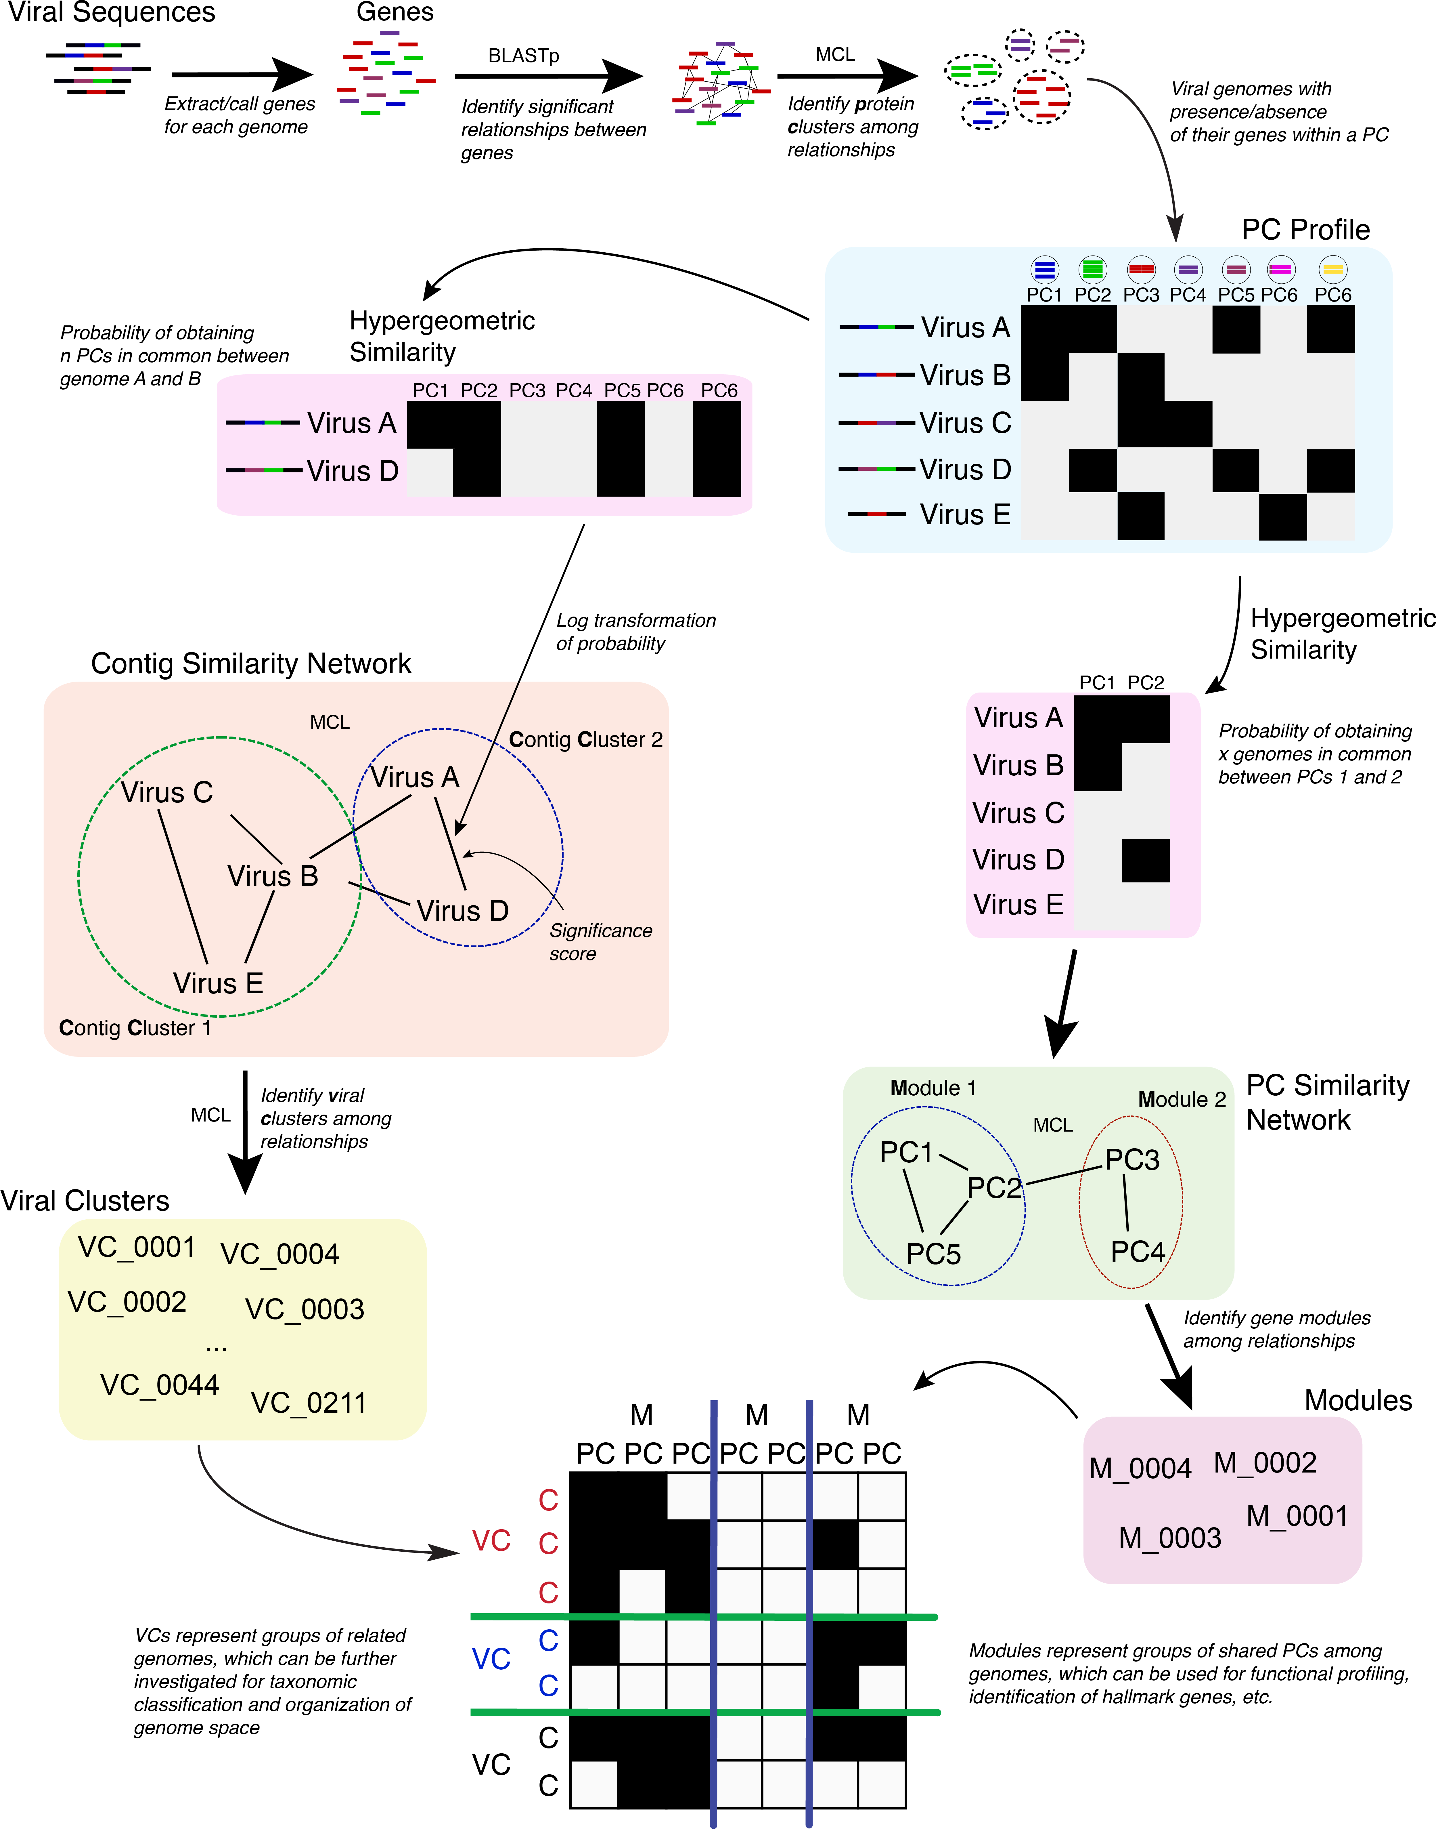
How to look for genome similarity?
(Bolduc et al. 2017)

Slide 38
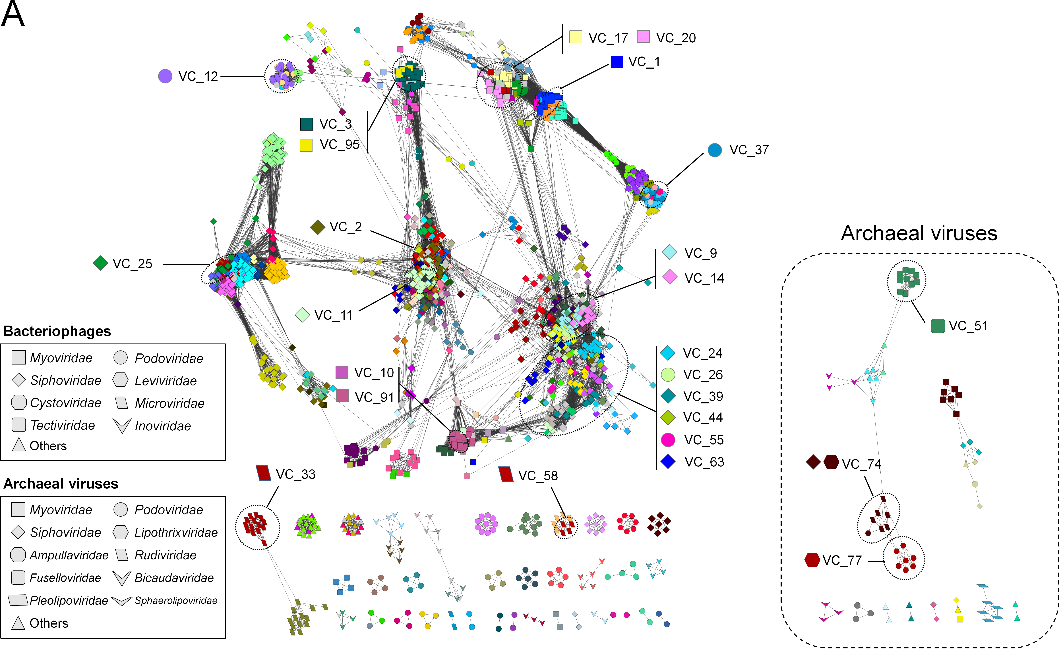
Protein sharing network
(Bolduc et al. 2017)

Slide 39
How does the Bifido Phylogeny look like
Look at plotly

Slide 40
Course overview
Gene and phage annotation (31.3)
Phage taxonomy (21.4)
CRISPR arrays, repeats and Cas-genes (28.4)
CRISPR-/Proto-spacer (5.5)
Conclusions (12.5)

Slide 41
Todays Overview
Group session (with Philipp)
Recap last session
Looking into phage genome annotations
Finish first part (Prophage annotation)
CRISPR-cas introduction
Run CRISPRcasFinder
CAS-cluster annotation (subgroup work)
Outlook for next week

Slide 42
Recap last session

Slide 43
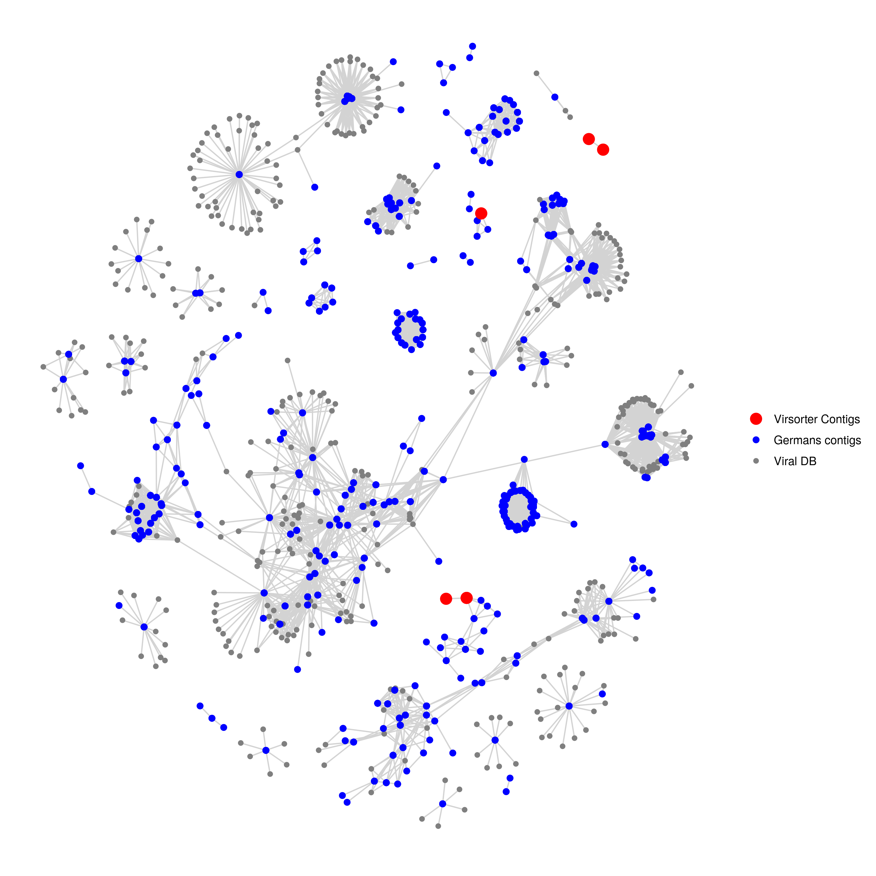
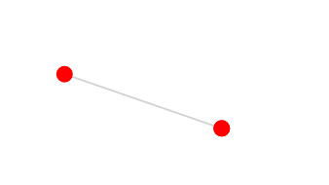
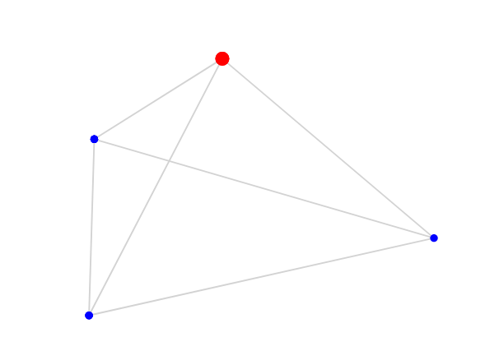
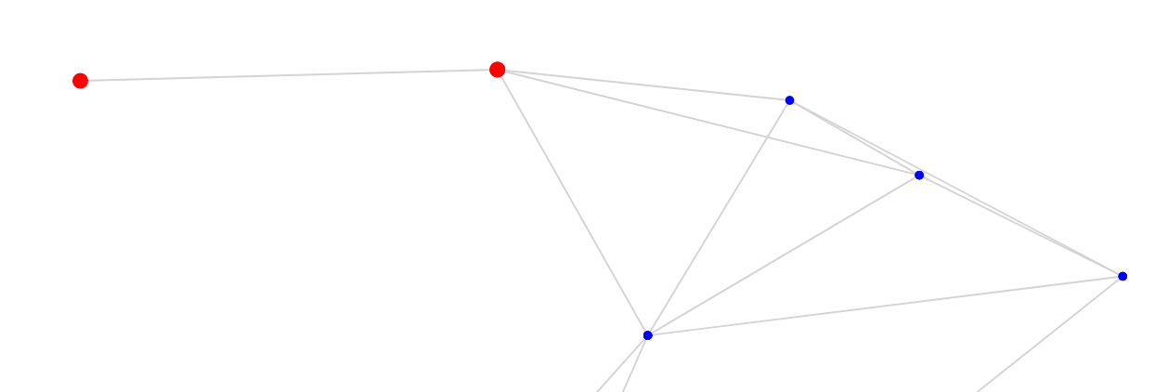
Phagen network
category 3 (not so sure)
Ga0401710_02
Ga0401713_04
Ga0401710_01
Siphoviridae of Type1
category 2 (somewhat sure)
Siphoviridae of Type1
Ga0401713_02
Ga0401715_02
Missing:
category 2 (somewhat sure)
Ga0401710_03

Slide 44
Phagen network
category 3 (not so sure)
Ga0401710_02
Ga0401713_04
Ga0401710_01
Siphoviridae of Type1
category 2 (somewhat sure)
Siphoviridae of Type1
Ga0401713_02
Ga0401715_02
Missing:
category 2 (somewhat sure)
Ga0401710_03

Slide 45
Next steps
You can explore the network
You have the HTML file or code (github)
Which genomes co-cluster (NCBI)
Alignment of the clustering phages
With mauve you could see shared genes
http://darlinglab.org/mauve/mauve.html

Slide 46
Github (https://github.com/Freevini/SAGE2_Phages)
Version control tool
Keeping track of your code
Collaboration
interaction
Download the directory or look online.
Comment (issues)
Change and submit code yourself!

Slide 47
Looking into phage genome annotations
What do you have?
Where do you have problems?
What do you want to do?

Slide 48
Finish first part (Prophage annotation)
What did we do?
What do you want to show?
What still needs to be done?

Slide 49

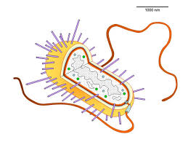
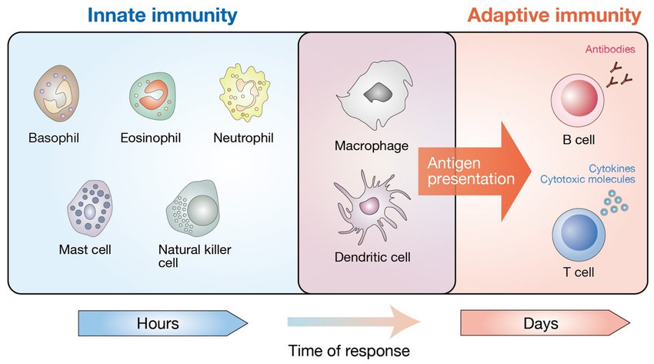
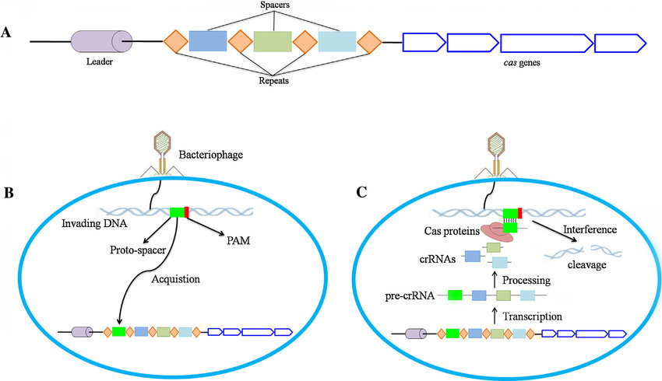
CRISPR-cas: The immunsystem of bacteria

Slide 50
What is needed for a adaptive immune system
Can recognise unwanted
Can destroy/kill unwanted
Can change/adapt to encounters
Can distinguish between self/non-self
...

Slide 51
CRISPR-cas system components
CRISPR array
Cas-cluster
(anti-CRISPR on the phage side)

Slide 52
CRISPR-cas system components
CRISPR array
Spacers are the actual matching regions against the “phages”
Repeats are the flanking regions that divide the spacers

Slide 53
CRISPR-cas system components
Cas-cluster
Cas-genes are the actual scissors. The cleave the targeted “phage” region.
There is a big diversity of Cas-genes. This are used to identify the CRISPR type.

Slide 54
Three crucial steps in CRISPR-cas
Acquisition
Expression
Intereference
(…spacer remove)

Slide 55
Three crucial steps in CRISPR-cas
Acquisition
- Detection of free DNA (ssDNA or dsDNA) by Cas-gene
- Identification of Protospacer adjacent Motif (PAM). Short motif to distinghish between self and non-self.
- Insertetion into the genome from the leader side (CRISPR spacer directionality)

Slide 56
Three crucial steps in CRISPR-cas
Expression
- transcription (to RNA) of CRISPR array.
- Processing to single CRISPR spacers crRNAs
- searching for matching regions

Slide 57
Three crucial steps in CRISPR-cas
Intereference
- detection and matching to protospacer and PAM.
- combining with Cas-proteins
- interference by cleavage
Why no self recognitation?

Slide 58
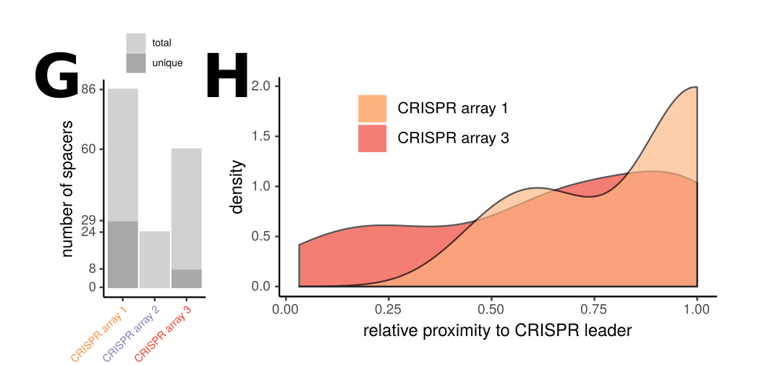
Three crucial steps in CRISPR-cas
…spacer remove
Unique spacers = more recent spacers

Slide 59
CRISPR-cas system
CRISPR array
Cas-cluster
(anti-CRISPR on the phage side)

Slide 60
How can we detect CRISPR-cas genes
Look at genome annotation
For Cas, csn, csm (e.g. with grep)
Use specialised command line tools.
PilerCR (looks for palindromic repeats)
Use online tool
CRISPRmap
CRISPRcasfinder

Slide 61
CRISPRcasfinder
Useful online tool to detect CRISPR arrays and CAS-genes
Extensive database for typing and subtyping
https://crisprcas.i2bc.paris-saclay.fr/
Try it out with the Bacterialgenomes

Slide 62
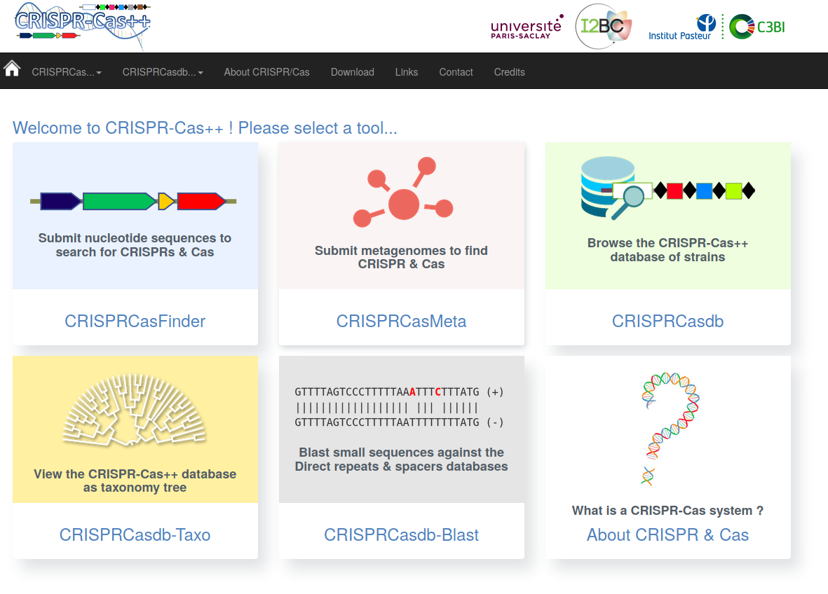
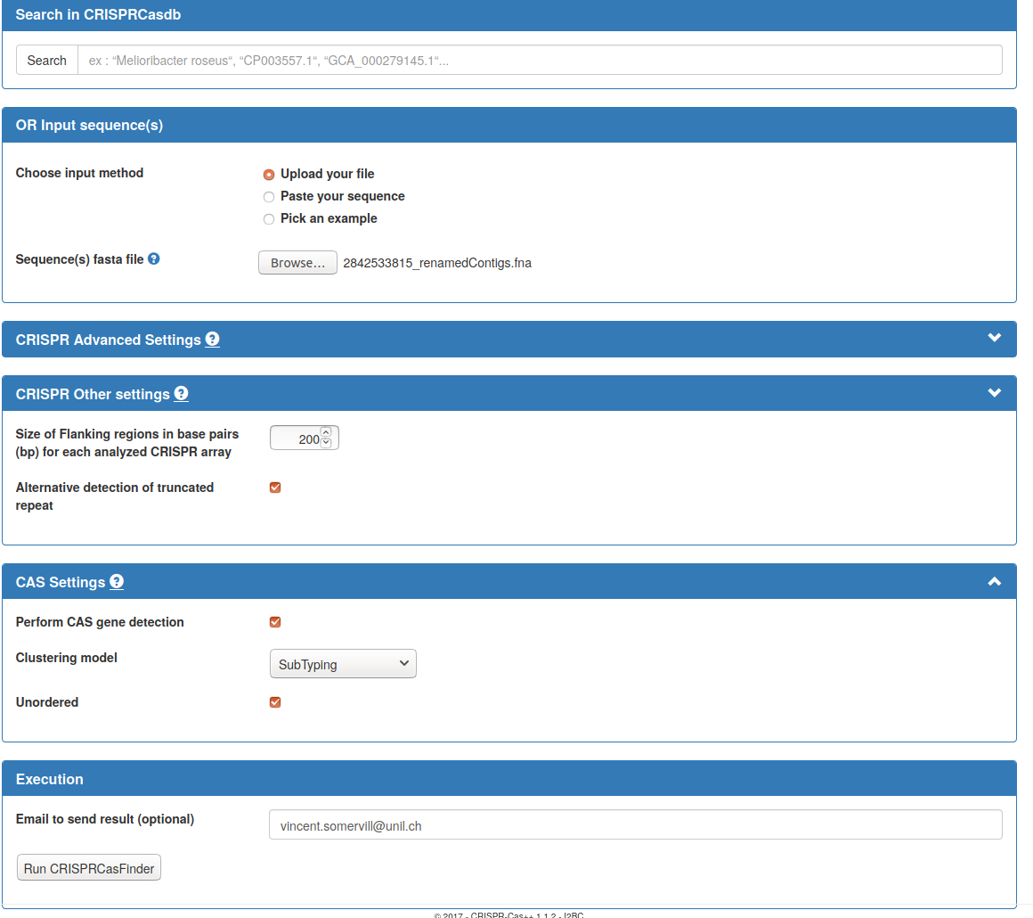
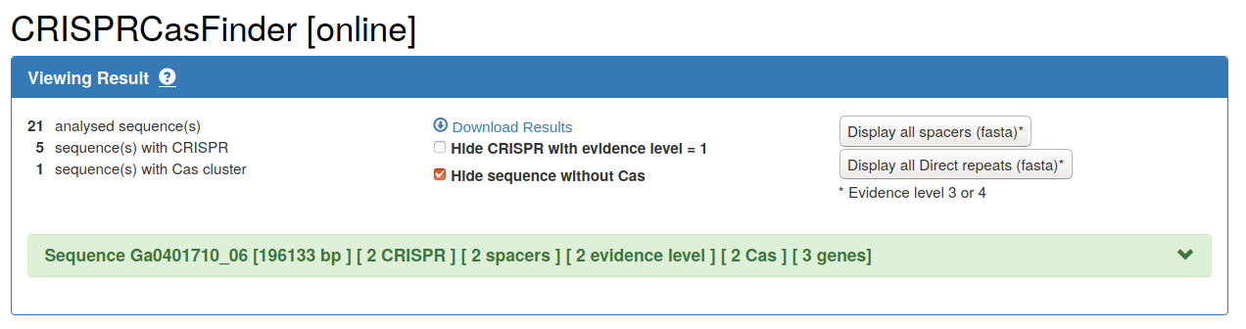
How to CRISPRcasfinder?
1
2
Submit the bacterial
contigs
200bp
tick
tick
subtyping
3
tick
Hide sequence without Cas
Email adresse

Slide 63
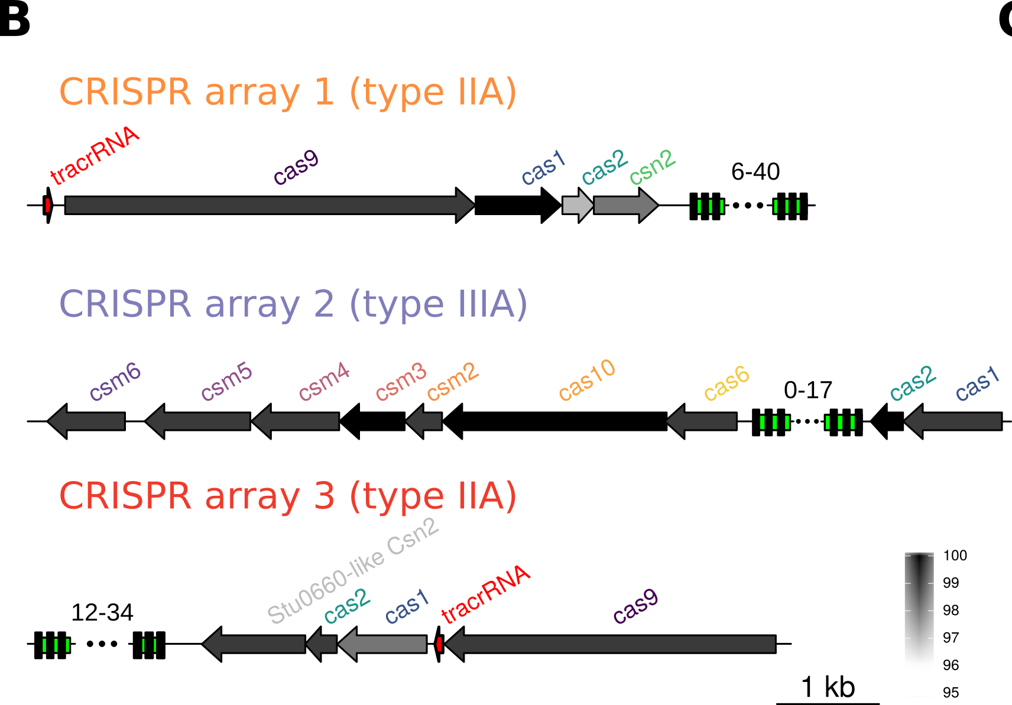
Make a figure of your Cas-genes
- download the CRISPRcasfinder output files
- Reuse your R code from the prophage annotation to creat an image

Slide 64
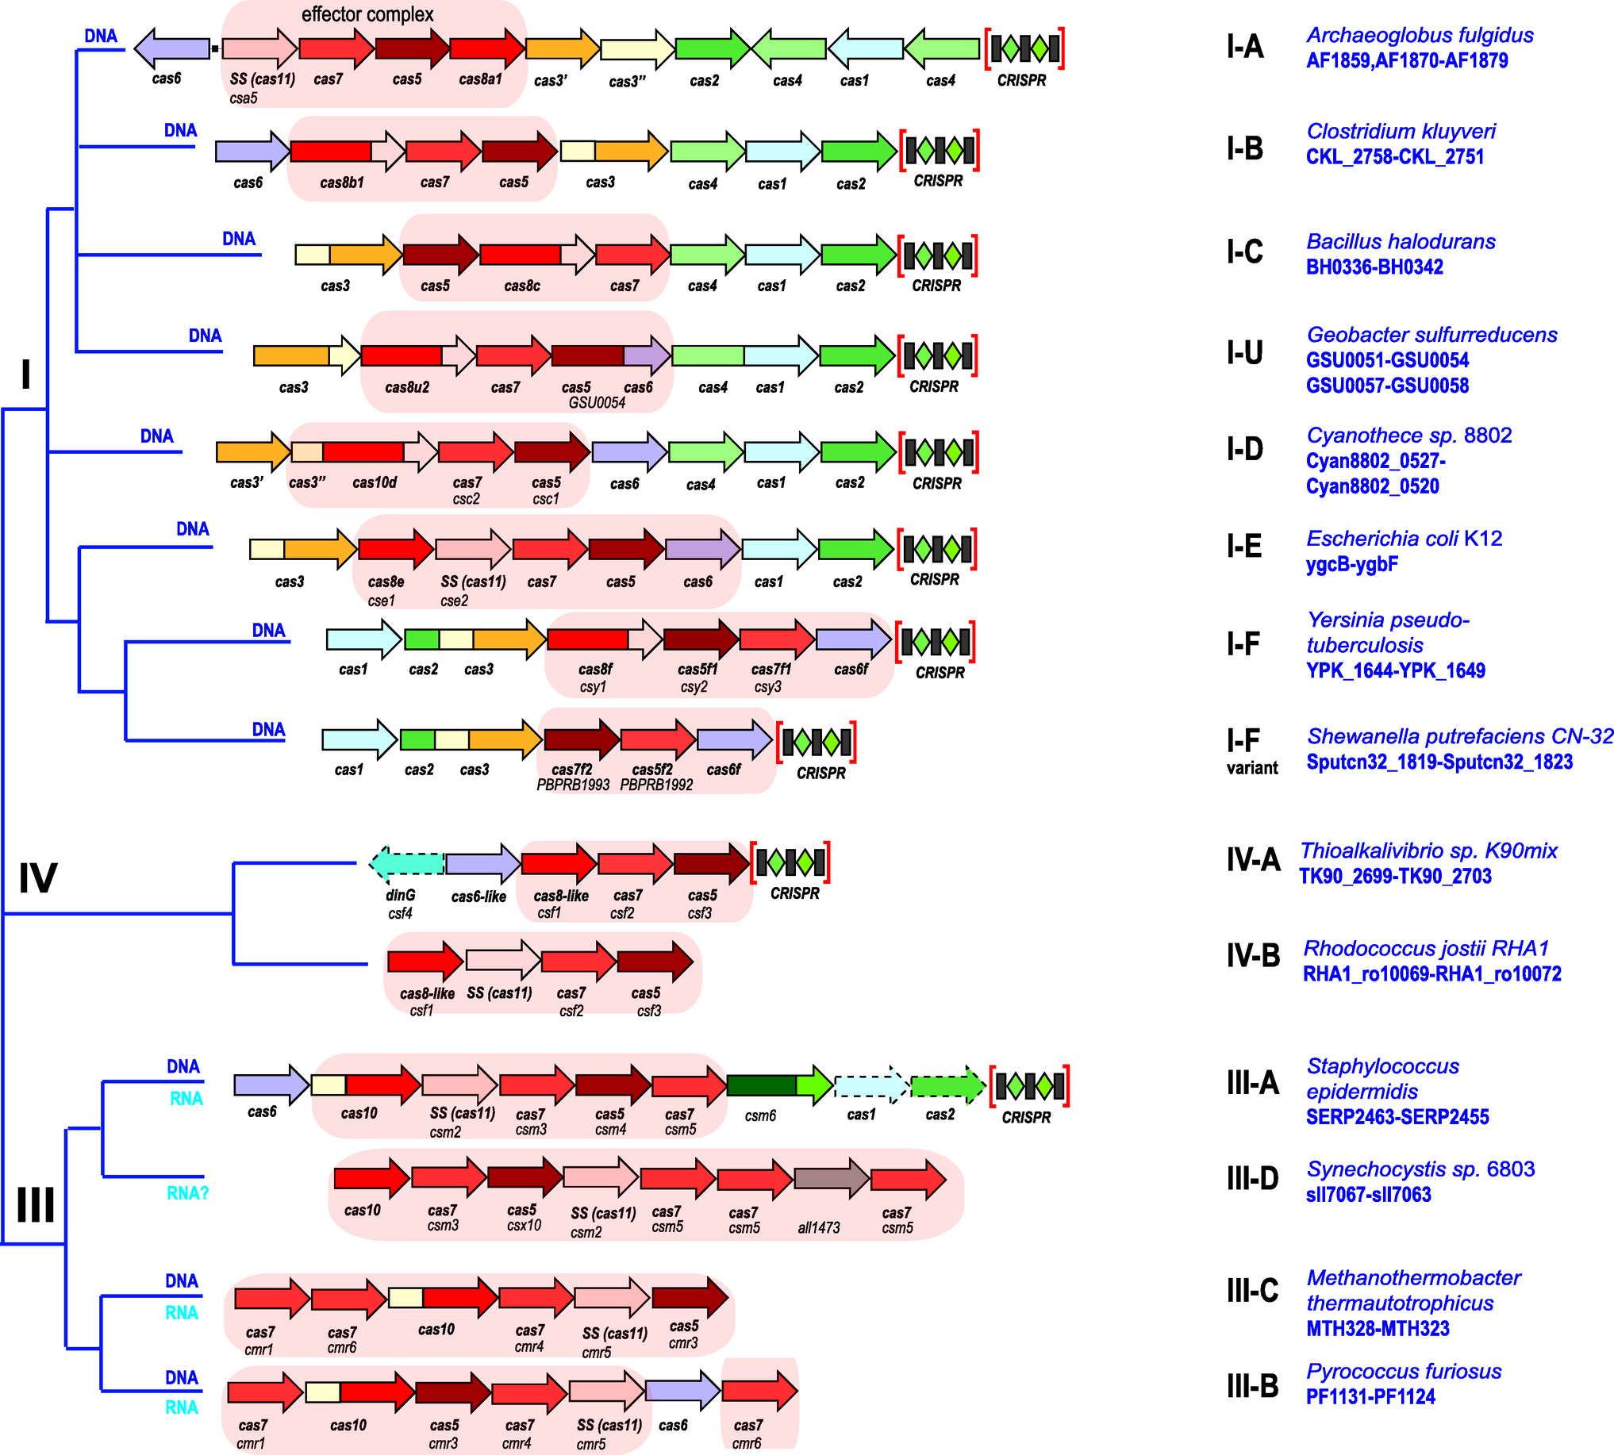
Outlook for next week
Identify our CRISPR types by comparing to literature
Learn more about bifidobacterium CRISPR
Spacer analysis

Slide 65
The end session 3

Slide 66
preperation

Slide 67
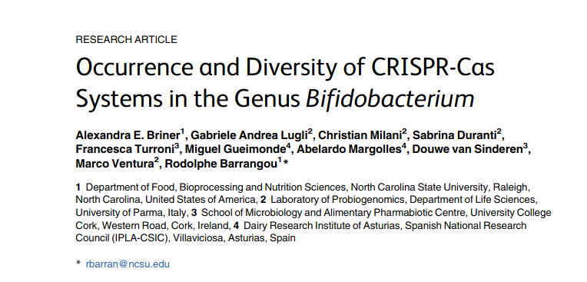
NUPACK was used to generate RNA folding prediction images
CRISPR types in Bifidobacterium
Bifidobacteriumspecieshave a very high frequency of CRISPR-Cas occurrence (77%, 37 of 48).
Type designation was confirmed by the presence ofcas3,cas9, andcas10forType I, II, and III respectively.
CRISPR spacers in bifidobacteria show perfect homology toprophage sequences harbored in the chromosomes of other species ofBifidobacterium,including some spacers that self-target the chromosome.
https://www.ncbi.nlm.nih.gov/pmc/articles/PMC4521832/pdf/pone.0133661.pdf

Slide 68
How do you get phage DNA

Slide 69
What is known about Bifido phages?

Slide 70
CRISPR-cas intro
https://www.ncbi.nlm.nih.gov/pmc/articles/PMC5901762/
Cas3 in type I systems, Cas9 in type II, and Cas10 in type III (Evolution and classification of the CRISPR-Cas systems)
Type II CRISPR-Cas systems are currently classified into three subtypes (II-A, II-B, and II-C), two of which were introduced in the updated classification
Type II-A systems encompass an additional gene, known as csn2

Slide 71
